Slide 1
Maintaining the DW
🔧
✅ Maintaining a Data Warehouse – Easy Explanation
A data warehouse is a large collection of data gathered from different sources, used for analysis and reporting. Maintaining it means keeping the data accurate, organized, and up to date.
Steps for Maintaining a Data Warehouse
📥 1. Data Loading (ETL Process)
ETL stands for Extract, Transform, and Load.
This is how new data is added to the warehouse:
Extract: Collect data from various sources (databases, files, etc.).
Transform: Clean, format, and organize the data.
Load: Store the processed data into the warehouse.
✅ Example: A retail company extracts sales data from its stores, transforms it into a consistent format, and loads it into the data warehouse daily.

Slide 2
Maintaining the DW
🔧
🔍 2. Data Cleaning and Quality Control
Ensure the data is correct, consistent, and free of errors.
Remove duplicate, incomplete, or incorrect records.
Validate the accuracy of data regularly.
✅ Example: If two records have the same customer ID but different contact numbers, the system flags the inconsistency for correction.
🔄 3. Data Refreshing and Updating
Regularly update the data to reflect the latest information.
Some warehouses update in real-time, while others refresh daily or weekly.
✅ Example: An e-commerce company refreshes its warehouse every night to include the day’s sales and inventory data.

Slide 3
Maintaining the DW
🔧
🔒 4. Data Backup and Recovery
Regularly back up the data to avoid loss.
Implement a recovery plan in case of system failure.
Use cloud storage or external servers for backup.
✅ Example: A bank backs up its transaction data every hour to prevent loss in case of a syste
📊 5. Indexing and Optimization
Create indexes to make searching faster.
Optimize queries to improve performance.
Remove outdated or rarely used data.
✅ Example: A company creates an index on the "CustomerID" field, making it faster to retrieve customer information.

Slide 4
Maintaining the DW
🔧
🔐 6. Security and Access Control
Protect the data with passwords, encryption, and access controls.
Grant access based on user roles (e.g., only finance teams can see financial data).
✅ Example: An HR team can access employee records, but only the finance team can view salary details.
🚀 Key Takeaway
Maintaining a data warehouse involves:
ETL processing to load new data.
Cleaning and quality control to keep data accurate.
Regular backups to prevent data loss.
Optimization for fast performance.
Security measures to protect sensitive information.
This ensures the data warehouse stays reliable, efficient, and secure for business analysis.

Slide 5
Maintaining the DW
🔧
What is Data Governance?
Data governance means managing and controlling data to ensure it is:
Accurate
Consistent
Secure
Used properly
In a data warehouse, data governance ensures that the data is:
Reliable for reporting and decision-making.
Protected from unauthorized access.
Consistently formatted across different sources.

Slide 6
Maintaining the DW
🔧
🔧
Key Components of Data Governance in a Data Warehouse
🔍 1. Data Quality Management
Ensures the data is correct, complete, and reliable.
Removes duplicates and errors.
Validates the data regularly.
✅ Example: If customer data from multiple branches is loaded into the warehouse, governance ensures that names, phone numbers, and addresses follow the same format and contain no missing values.

Slide 7
Maintaining the DW
🔧
🔧
🔒 2. Data Security and Privacy
Protects sensitive data (e.g., customer details, financial records).
Uses encryption, passwords, and access control.
Ensures only authorized users can access certain data.
✅ Example: In a healthcare warehouse, only authorized doctors can access patient records, while the billing team can only view payment data.
📜 3. Data Standards and Policies
Defines rules and guidelines for how data should be stored and used.
Ensures consistent formatting (e.g., date formats, currency symbols).
Specifies naming conventions for tables, columns, and files.
✅ Example: In a sales warehouse:
Date format: YYYY-MM-DD for all entries.
Currency format: $ for USD, € for Euro.

Slide 8
Maintaining the DW
🔧
🔧
🔄 4. Data Lifecycle Management
Manages the entire journey of data:
Creation → Usage → Storage → Archiving → Deletion.
Ensures that old or unnecessary data is archived or deleted.
✅ Example: An e-commerce company archives customer orders older than 5 years to keep the warehouse clean and efficient.
🔧 5. Metadata Management
Metadata = data about data (e.g., table names, column descriptions).
Helps users understand and track the data.
Improves data discovery and consistency.
✅ Example: In a warehouse:
Table name: Sales_2024
Metadata: Contains details like date range, region, and currency.

Slide 9
Maintaining the DW
🔧
🔧
📊 6. Data Auditing and Monitoring
Tracks who accessed or changed the data.
Audits ensure that data usage complies with rules.
Identifies suspicious or unauthorized activity.
✅ Example: A bank tracks who accessed financial records and creates reports for security audits.
🚀 Key Takeaway
Data governance in a data warehouse ensures:
Accurate and reliable data for decision-making.
Secure and private storage of sensitive data.
Consistent formatting across different data sources.
Clear rules and standards for data usage and access.
This makes the data trustworthy, safe, and useful for business analysis.

Slide 10
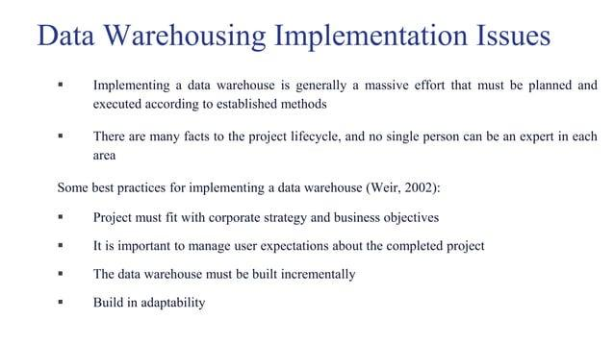

Slide 11
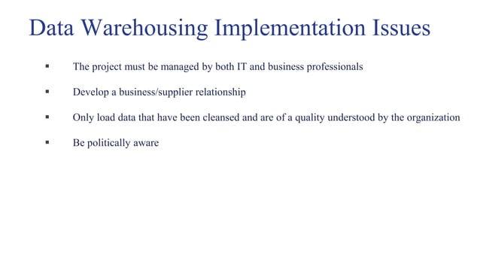

Slide 12
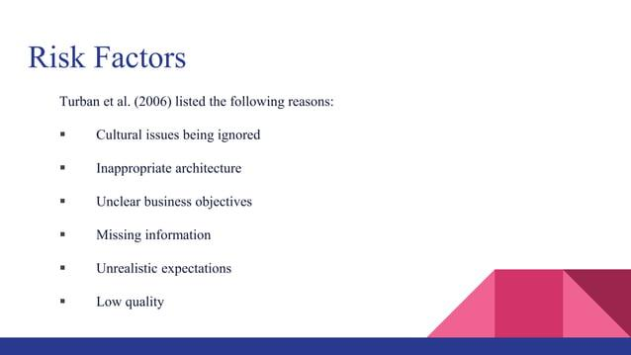

Slide 13
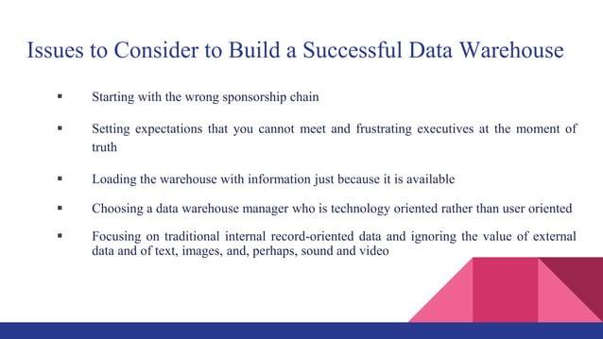

Slide 14
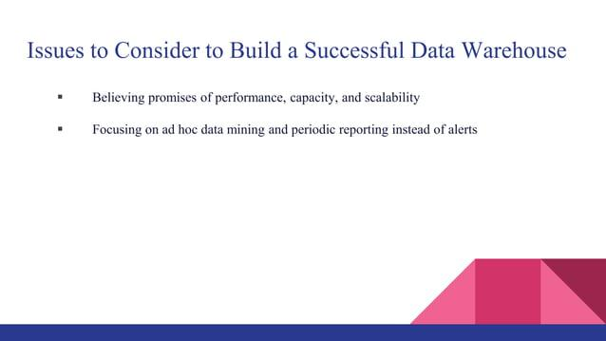

Slide 15
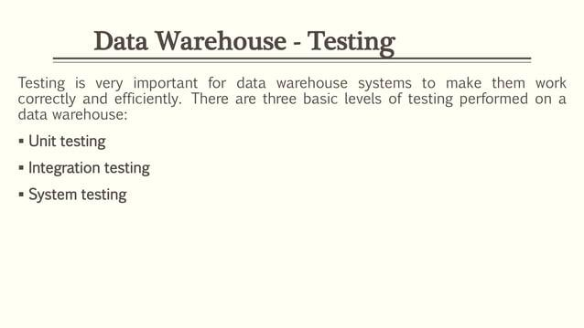

Slide 16
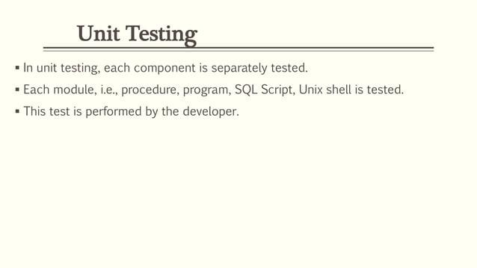

Slide 17
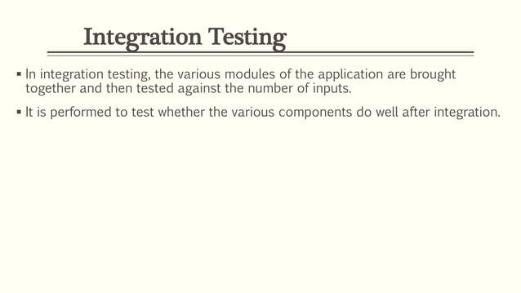

Slide 18
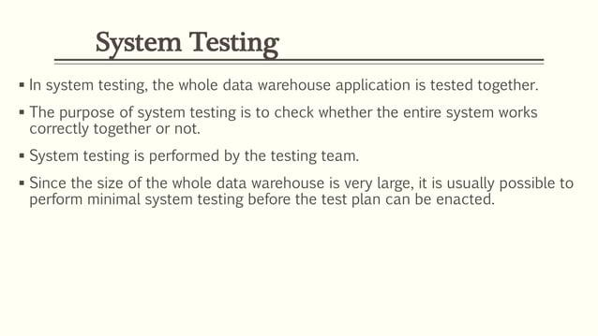

Slide 19
Cloud-Based Data Warehousing
💡 What is Cloud-Based Data Warehousing?
A cloud-based data warehouse is a large data storage system hosted on the internet (cloud) instead of on physical servers. It is used to:
Store massive amounts of data.
Process and analyze data quickly.
Provide on-demand access from anywhere.
🌐 How It Works
Data Collection: Data is collected from different sources (e.g., sales, marketing, customer databases).
Storage in the Cloud: The data is stored in cloud servers (Amazon AWS, Google Cloud, Microsoft Azure, etc.).
Data Analysis: You can run queries, reports, and visualizations using cloud-based tools.
Access Anytime, Anywhere: Since it’s on the cloud, you can access it remotely from any device with an internet connection.

Slide 20
Cloud-Based Data Warehousing
🛠️ Popular Cloud Data Warehousing Services
Amazon Redshift: Used for large-scale data storage and analysis.
Google BigQuery: Offers fast SQL-like querying on large datasets.
Snowflake: A flexible, easy-to-use cloud warehouse with fast performance.
Microsoft Azure Synapse Analytics: Used for big data processing and analytics.
🔧 Advantages of Cloud-Based Data Warehousing
📊 1. Scalability
You can increase or decrease the storage and processing power as needed.
No need to buy new servers or hardware.
✅ Example: An e-commerce company experiences heavy traffic during sales season. It can scale up the cloud warehouse for faster performance and scale it down afterward.

Slide 21
Cloud-Based Data Warehousing
💰 2. Cost-Efficiency
You pay only for what you use (subscription or pay-as-you-go model).
No need for expensive physical servers or maintenance.
✅ Example: A small business only pays for the storage and processing it uses instead of investing in expensive on-premise hardware.
🚀 3. Faster Performance
Cloud warehouses use parallel processing for faster queries.
You can run complex data analysis in minutes.
✅ Example: A company uses Google BigQuery to analyze sales data from millions of transactions in seconds.

Slide 22
Cloud-Based Data Warehousing
🔒 4. Security and Backup
Cloud warehouses have built-in security features like encryption and access control.
Data is automatically backed up, preventing loss.
✅ Example: A financial company uses Snowflake to store customer records with encrypted access to protect sensitive data.
🔄 5. Accessibility and Collaboration
Teams can access the data from anywhere with an internet connection.
Multiple users can collaborate and work on the same data simultaneously.
✅ Example: A global company uses Amazon Redshift to let teams from different countries access and analyze the same data in real time.

Slide 23
Cloud-Based Data Warehousing
Key Takeaway
Cloud-based data warehousing offers:
Flexible and scalable storage without physical servers.
Faster performance for large-scale data analysis.
Cost savings with pay-as-you-go pricing.
Secure and reliable backup with remote access.
It makes data management, analysis, and reporting faster, easier, and more efficient.

Slide 24
Future Trends in Data Warehousing
💡 What are Future Trends in Data Warehousing?
Data warehousing is constantly evolving with new technologies and methods to store, manage, and analyze data more efficiently. Here are some future trends you can expect:
🌐 1. Cloud-First Data Warehousing
More companies are moving their data warehouses to the cloud.
Cloud-based data warehouses offer faster performance, lower costs, and easier scalability.
Providers like Amazon Redshift, Google BigQuery, Snowflake, and Azure Synapse are becoming more popular.
✅ Example: A company uses Google BigQuery to store and analyze massive customer data without investing in physical servers.

Slide 25
Future Trends in Data Warehousing
🤖 2. Use of Artificial Intelligence (AI) and Machine Learning (ML)
Data warehouses will integrate AI and ML to automate data processing and gain deeper insights.
AI will help predict trends and suggest actions based on data patterns.
Automated data cleaning and quality checks will become common.
✅ Example: A retail company uses AI-powered warehousing to predict customer demand and automatically adjust stock levels.
🔥 3. Real-Time Data Warehousing
Traditional data warehouses process data in batches (e.g., daily updates).
The future will focus on real-time data processing, allowing companies to make instant decisions.
Real-time data helps with fraud detection, live customer insights, and immediate reporting.
✅ Example: A bank uses real-time data warehousing to detect and stop fraudulent transactions as they happen.

Slide 26
Future Trends in Data Warehousing
🔄 4. Data Lakes Integration
Companies will combine data lakes and data warehouses.
Data lakes store raw, unstructured data (e.g., images, videos).
Data warehouses store structured, processed data.
The integration will allow businesses to access both types of data from one platform.
✅ Example: A healthcare company uses a data lake for X-ray images and a data warehouse for patient records, allowing doctors to view both together.
🔒 5. Enhanced Data Security and Privacy
With growing data privacy regulations (like GDPR and CCPA), warehouses will focus on stronger security.
Data masking, encryption, and access control will become standard.
More warehouses will include automated compliance checks.
✅ Example: A financial company uses automated encryption in its data warehouse to protect customer information.

Slide 27
Future Trends in Data Warehousing
⚙️ 6. Automation and Self-Service Analytics
Data warehousing will become more automated.
Self-service analytics tools will allow employees (even non-tech users) to easily create reports.
Drag-and-drop interfaces will make data analysis simpler.
✅ Example: A sales manager uses self-service tools to create real-time reports without needing help from the IT team.
🔍 7. Multi-Cloud and Hybrid Data Warehousing
Companies will use multiple cloud platforms to avoid being tied to one provider.
Hybrid solutions (cloud + on-premises) will be common.
This gives businesses more flexibility and reliability.
✅ Example: A company stores sensitive data on-premises for security but uses the cloud for analytics.

Slide 28
Future Trends in Data Warehousing
🚀 Key Takeaway
The future of data warehousing will include:
Cloud-first models for flexibility and speed.
AI and machine learning for smarter insights.
Real-time data processing for faster decisions.
Data lakes integration for handling all types of data.
Better security and privacy features.
These trends will make data warehousing faster, smarter, and more efficient, helping businesses make better decisions. 🚀

Slide 29


